Slide 1
SIT216
User Centred Design
Topic 4
The Design Process & Methods

Slide 2
Last topic...
Developing a design process
Understanding the elements of a user focused designed system
Benefits of designing usable interfaces

Slide 3
The Waterfall Model
Focuses on the technology
Often reflects the views of the developer
Technical view of how a system works
Processes are restricted by being strictly sequential - no parallel, no iteration
Requires the designer to get it right the first time
A poor model of how designers actually work

Slide 4
The Waterfall Model
Focuses on the technology
Often reflects the views of the developer
Technical view of how a system works
Processes are restricted by being strictly sequential - no parallel, no iteration,
Requires the designer to get it right the first time
A poor model of how designers actually work

Slide 5
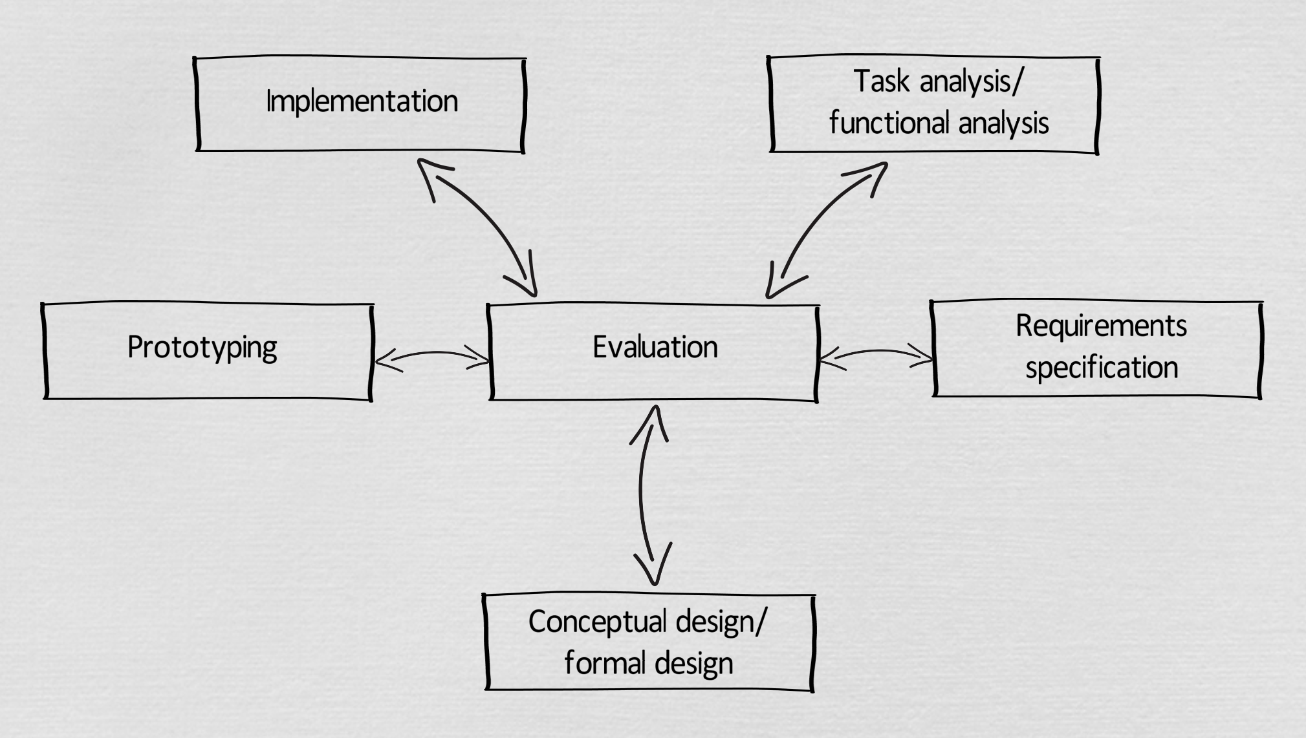
The Star Model

Slide 6
This Topic
Interface Design
User Centred Design
Design methodologies

Slide 7
Interface design
1

Slide 8
Interface Design
Design is inherently creative and unpredictable.
  Interactive system designers must blend knowledge of technical feasibility with a mystical esthetic sense of what attracts users.
Carroll and Rosson design characterisation:
  Design is a process, not a state.
  The design process is nonhierarchical.
  The process is radically transformational.
  Design intrinsically involves the discovery of new goals.

Slide 9
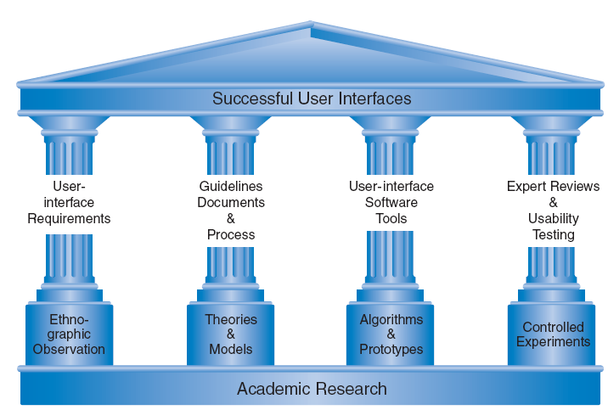
The Four Pillars of Design

Slide 10
Activity - Interface Design
With the students around you, discuss:
  A product/system/website you were (are) required to use that has received significant interface design changes over a period of time. Were you told why the changes were made? Were you (should you have been) asked about the changes before they were made?
Some of these examples will then be shared and discussed with the rest of the class.

Slide 11
Activity - Interface Design
Also with the students around you, consider the QQ website (https://www.qq.com/) and assess the visibility and affordance.
Remember:
  Visibility is defined as the ability for users to identify interaction elements on the screen with clear mapping.
  Affordance is defined as the ability to identify how to use the element and what will happen when the element is used.
Task:
  Use the QQ website to identify all of the interaction elements on the main homepage.
  For each element assess its visibility as Poor, OK or Good plus a short reason to explain your answer. Complete the same process for affordance.
Some of these examples will be shared and discussed in class today.

Slide 12
User Centred Design
2

Slide 13

The UCD Approach
Also known as Human Centred Design

Slide 14
The UCD Approach
Identify the user characteristics
  WHO will use the interface?
Identify the functionality of the interface
  WHAT is the interface supposed to do?
Identify the tasks needed to complete the functionality in the most efficient way
  HOW will the user work with the interface?
Are there site characteristics requiring special interaction mechanisms
  WHERE will the user use the interface?

Slide 15
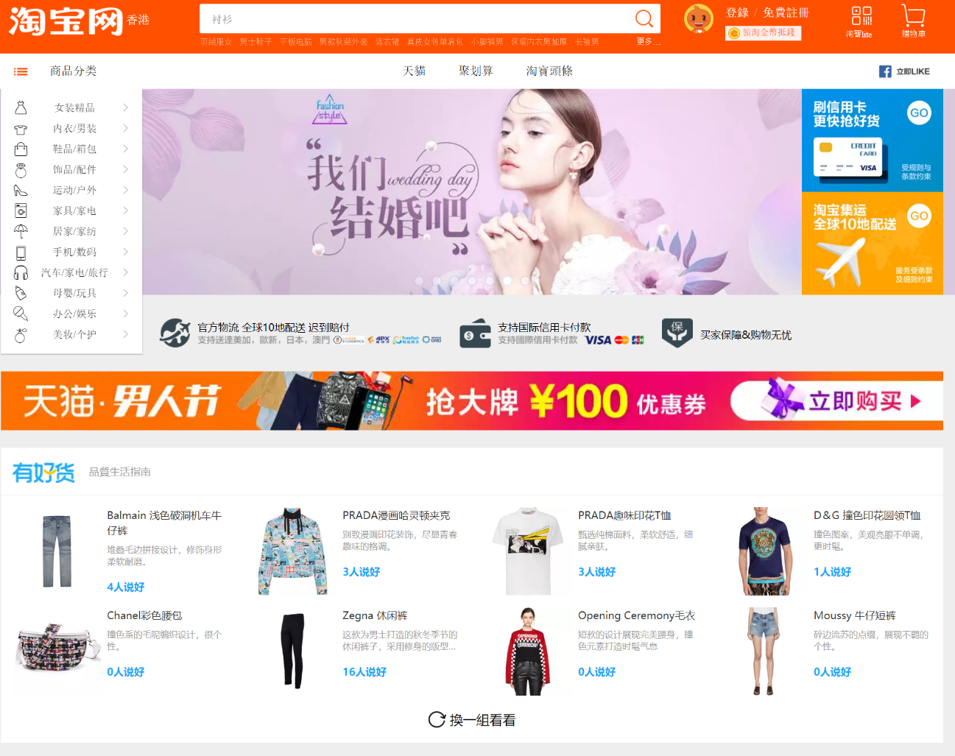
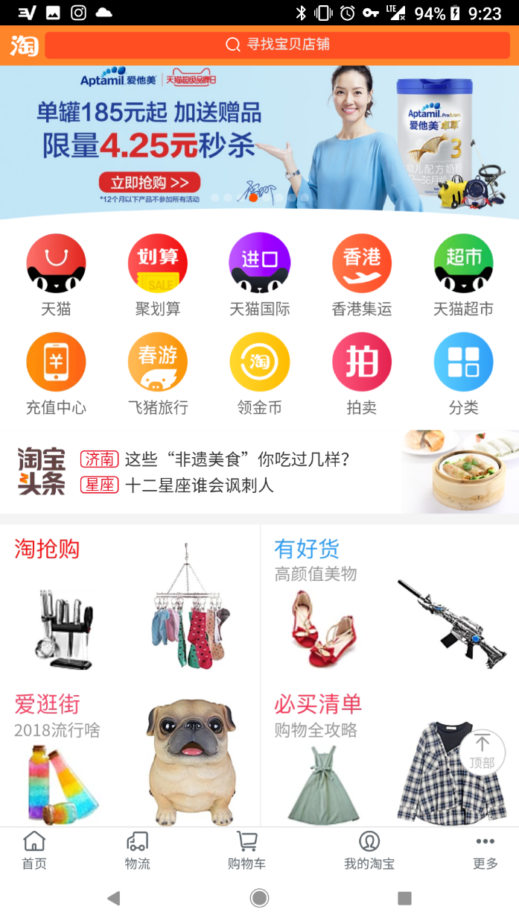
Activity – The UCD Approach – 淘宝 (Taobao)
Identify WHO – WHAT – HOW – WHERE for 淘宝 (Taobao)

Slide 16
The UCD Approach
Create the interface look and feel:
  Use of metaphors?
  Standard or specialised interaction elements?
  Organisation and layout
  Engagement and aesthetics
Where to get help?
  Standards
  Guidelines

Slide 17

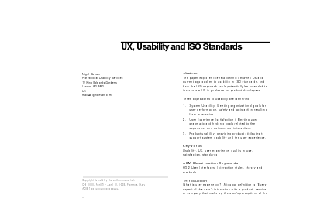
User Centred Design
Using Design Rules
  Standards
    set by national or international bodies
    require sound underlying theory and slowly changing technology
    hardware standards or more common software standards; ergonomics
    low-level of detail
    reports by ISO

Slide 18



User Centred Design
Using Design Rules (Continued)
  Guidelines
    more suggestive and general
    many textbooks and reports are full of guidelines
    abstract guidelines (principles) are applicable in the early stages of design
    detailed guidelines (style guides) are more applicable later in the design process
    conflict resolution

Slide 19
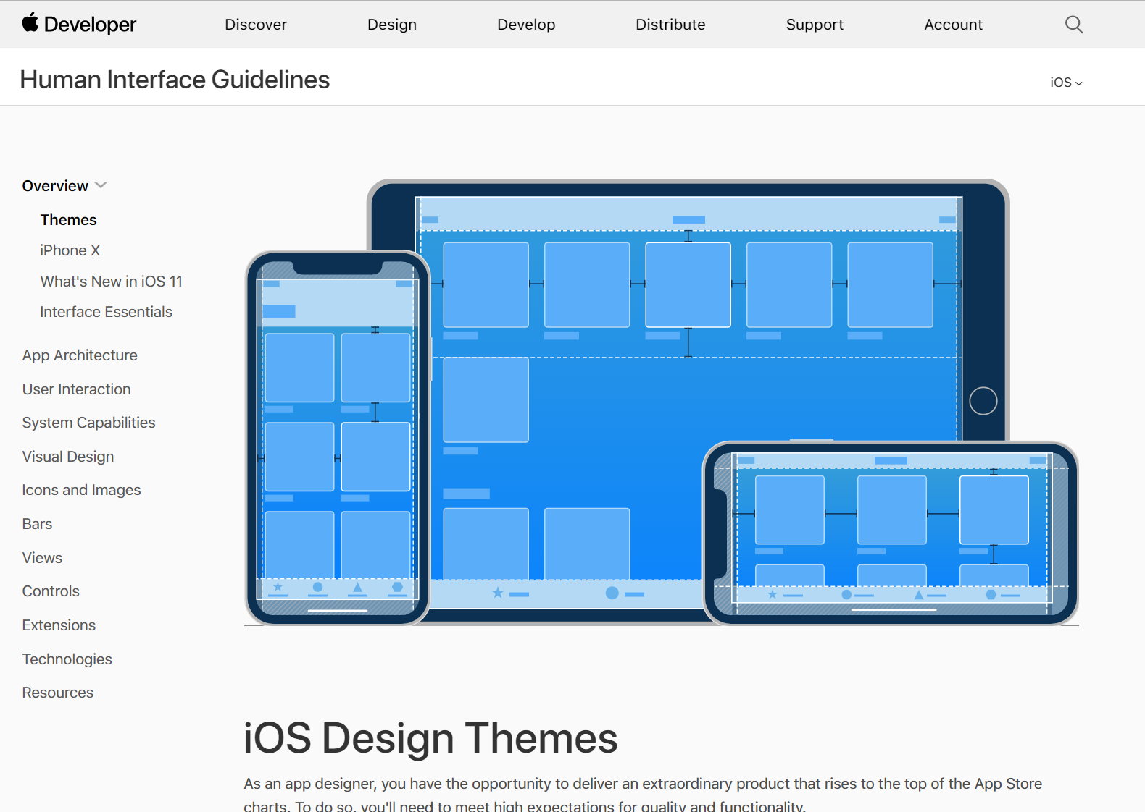
User Centred Design
https://developer.apple.com/design/human-interface-guidelines/ios/overview/themes/

Slide 20
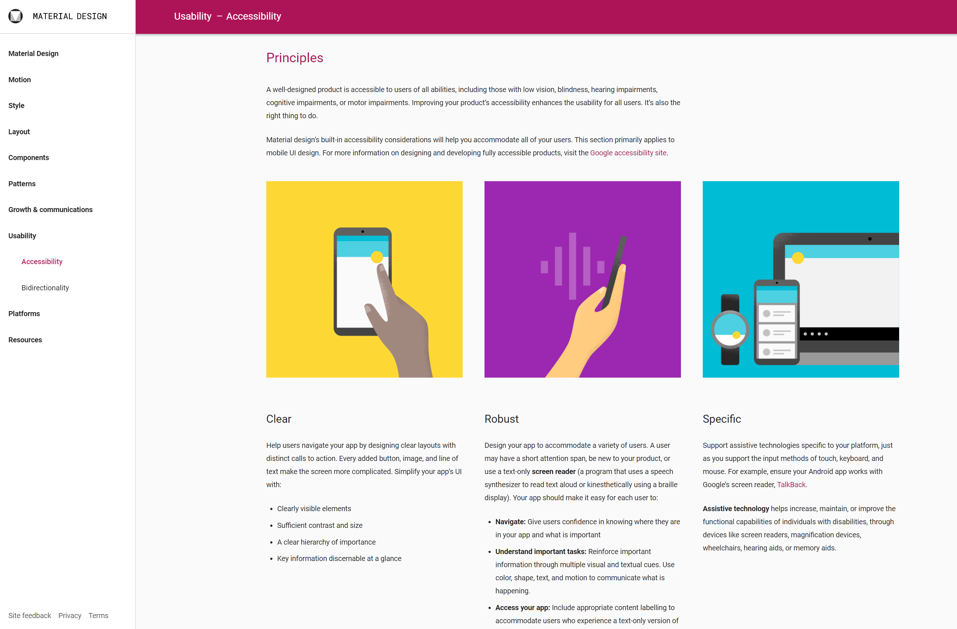
User Centred Design
https://material.io/design/guidelines-overview/

Slide 21
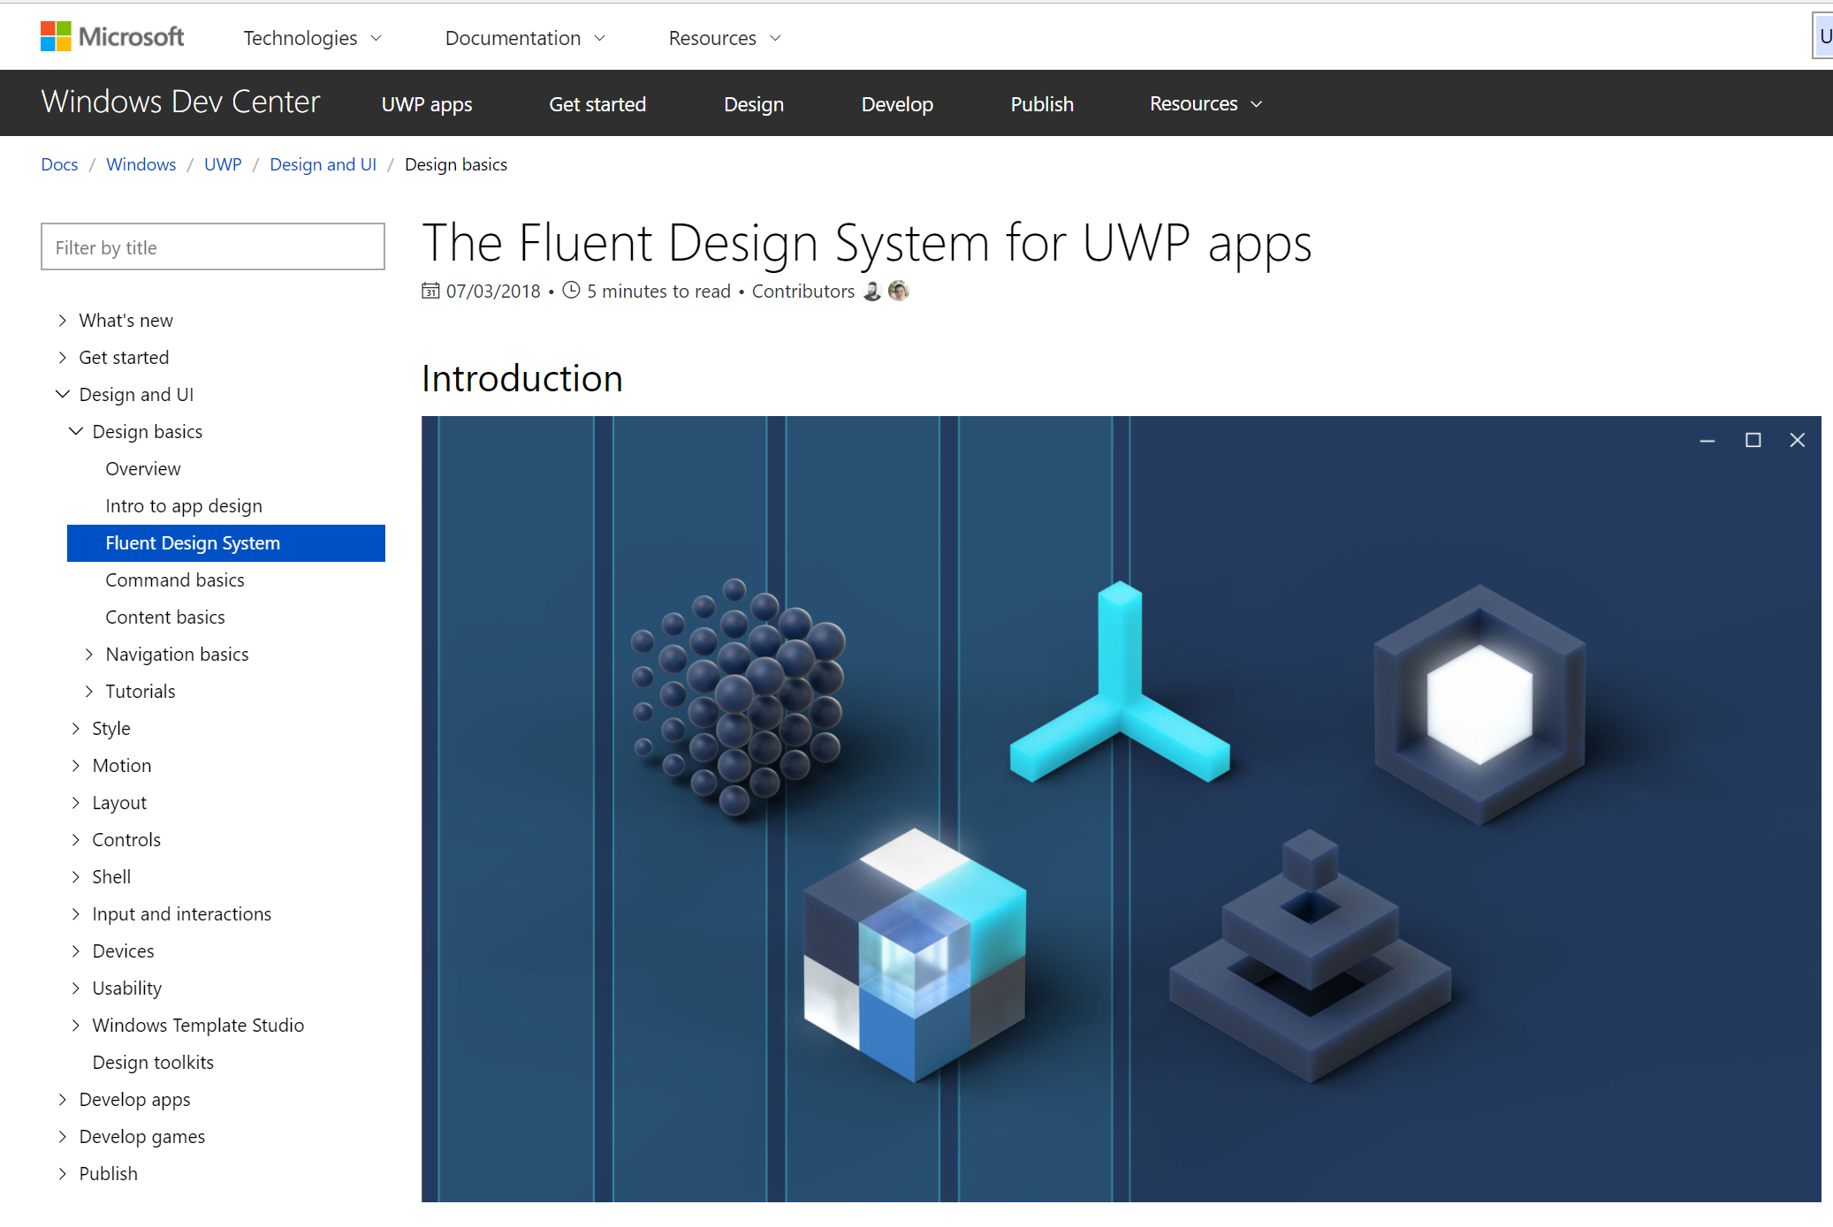
User Centred Design
https://docs.microsoft.com/en-au/windows/uwp/design/basics/

Slide 22
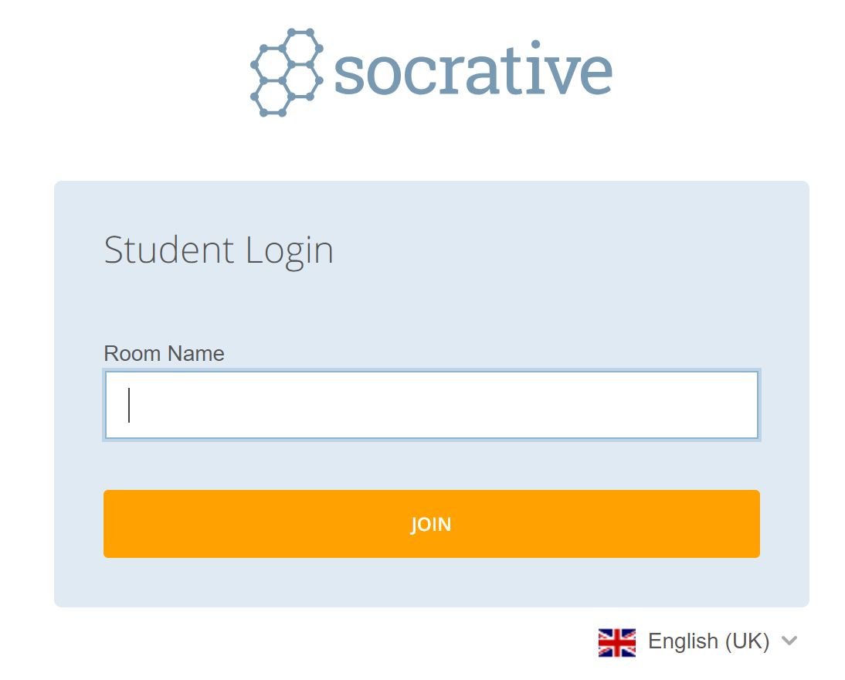
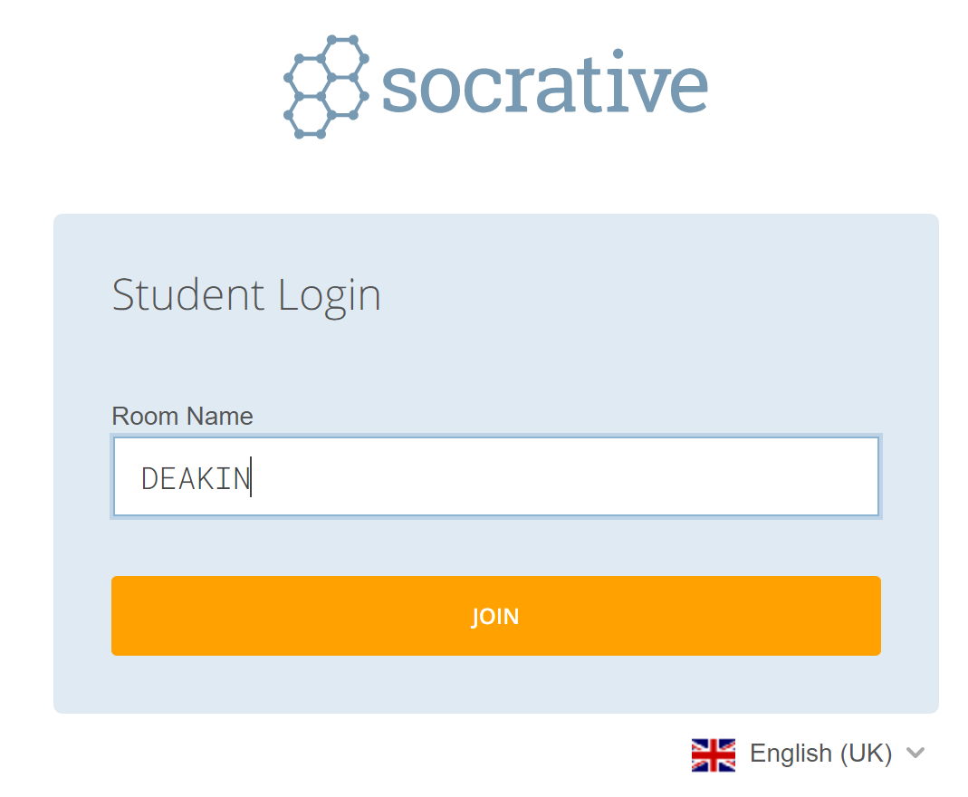
Activity – User Centred Design
Go to https://www.socrative.com/ on your phone or laptop
Click on ‘Student Login’:
Type ‘Deakin’ in the ‘Room Name’ field,
and then choose ‘Join’:
I will start a quiz to find out more on
your thoughts about standards and
guidelines.

Slide 23
Design Methods
3

Slide 24
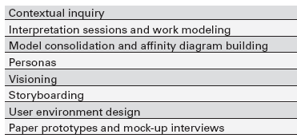
Design Methods
Rapid Contextual Design
From Holtzblatt, et al., Rapid Contextual Design:
A How-To Guide to Key Techniques for User-Centered Design

Slide 25
Design Methods
Rapid Contextual Design (continued)
  Contextual inquiry involves collecting detailed information about customer work practice by observing and interviewing the user while they actually work.
  One-on-one interviews with users in their workplace.
  During or after the observations, discussion occurs to discover the best design for the process.

Slide 26
Design Methods
Ethnographic Observation
  Preparation
    Understand organisation policies and work culture.
    Familiarise yourself with the system and its history.
    Set initial goals and prepare questions.
    Gain access and permission to observe/interview.
  Field Study
    Establish rapport with managers and users.
    Observe/interview users in their workplace and collect
    subjective/objective quantitative/qualitative data.
    Follow any leads that emerge from the visits.

Slide 27
Design Methods
Ethnographic Observation
  Analysis
    Compile the collected data in numerical, textual, and multimedia databases.
    Quantify data and compile statistics.
    Reduce and interpret the data.
    Refine the goals and the process used.
  Reporting
    Consider multiple audiences and goals.
    Prepare a report and present the findings.

Slide 28
Design Methods
Participatory Design
  More controversial as a methodology
  More user involvement brings:
    more accurate information about tasks
    more opportunity for users to influence design decisions
    a sense of participation that builds users' ego investment in successful implementation
    potential for increased user acceptance of final system

Slide 29
Design Methods
Participatory Design
  On the negative side, extensive user involvement may:
    be more costly
    lengthen the implementation period
    build antagonism with people not involved or whose suggestions rejected
    force designers to compromise their design to satisfy incompetent participants
    build opposition to implementation
    exacerbate personality conflicts between design-team members and users
    show that organisational politics and preferences of certain individuals are more important than technical issues

Slide 30
Activity - Design Methods
Discuss the following situations (what would you do/what would you say) with the students around you:
  Members of your large design team did not want to create personas
  The types of questions you could ask a target user before implementing a new system
  Behaviours (think about spoken words and body language) you would use to build up trust among users and the client
  Manage the users involved in the project to help receive useful information is provided when using the ‘participatory design’ method.
You can research these topics online, however, your answers should be based on the discussion in your small group.

Slide 31
Summary
UCD process focuses on the user
Places the user, their goals, needs and activities at the core of the design process
Significant aspects of this approach are the cyclic aspects of iteration and evaluation
NOT a linear nor rigid process
Different methodologies can be used.

Slide 32
Next topic
Interaction design

